Slide 1


Principals Of Programming Languages
DR. saeed ur rehman
Department of Computer Science
COMSATS University Islamabad
Wah Campus

Slide 2
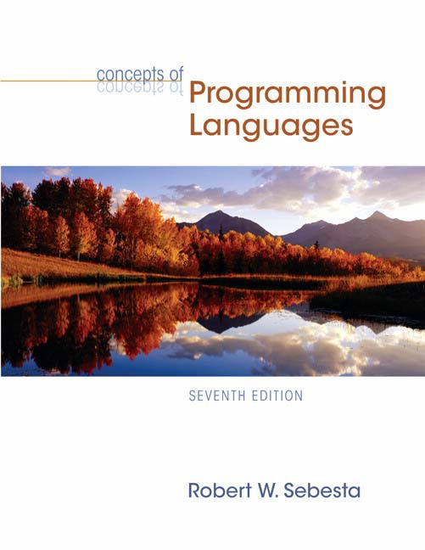
Chapter 2
Evolution of the Major Programming Languages

Slide 3
Chapter 2 Topics
Zuse’s Plankalkul
Minimal Hardware Programming: Pseudocodes
The IBM 704 and Fortran
Functional Programming: LISP
The First Step Toward Sophistication: ALGOL 60
Computerizing Business Records: COBOL
The Beginnings of Timesharing: BASIC

Slide 4
Chapter 2 Topics (continued)
Everything for Everybody: PL/I
Two Early Dynamic Languages: APL and SNOBOL
The Beginnings of Data Abstraction: SIMULA 67
Orthogonal Design: ALGOL 68
Some Early Descendants of the ALGOLs
Programming Based on Logic: Prolog
History's Largest Design Effort: Ada

Slide 5
Chapter 2 Topics (continued)
Object-Oriented Programming: Smalltalk
Combining Imperative ad Object-Oriented Features: C++
An Imperative-Based Object-Oriented Language: Java
Scripting Languages: JavaScript, PHP, and Python
A C-Based Language for the New Millennium: C#
Markup/Programming Hybrid Languages

Slide 6
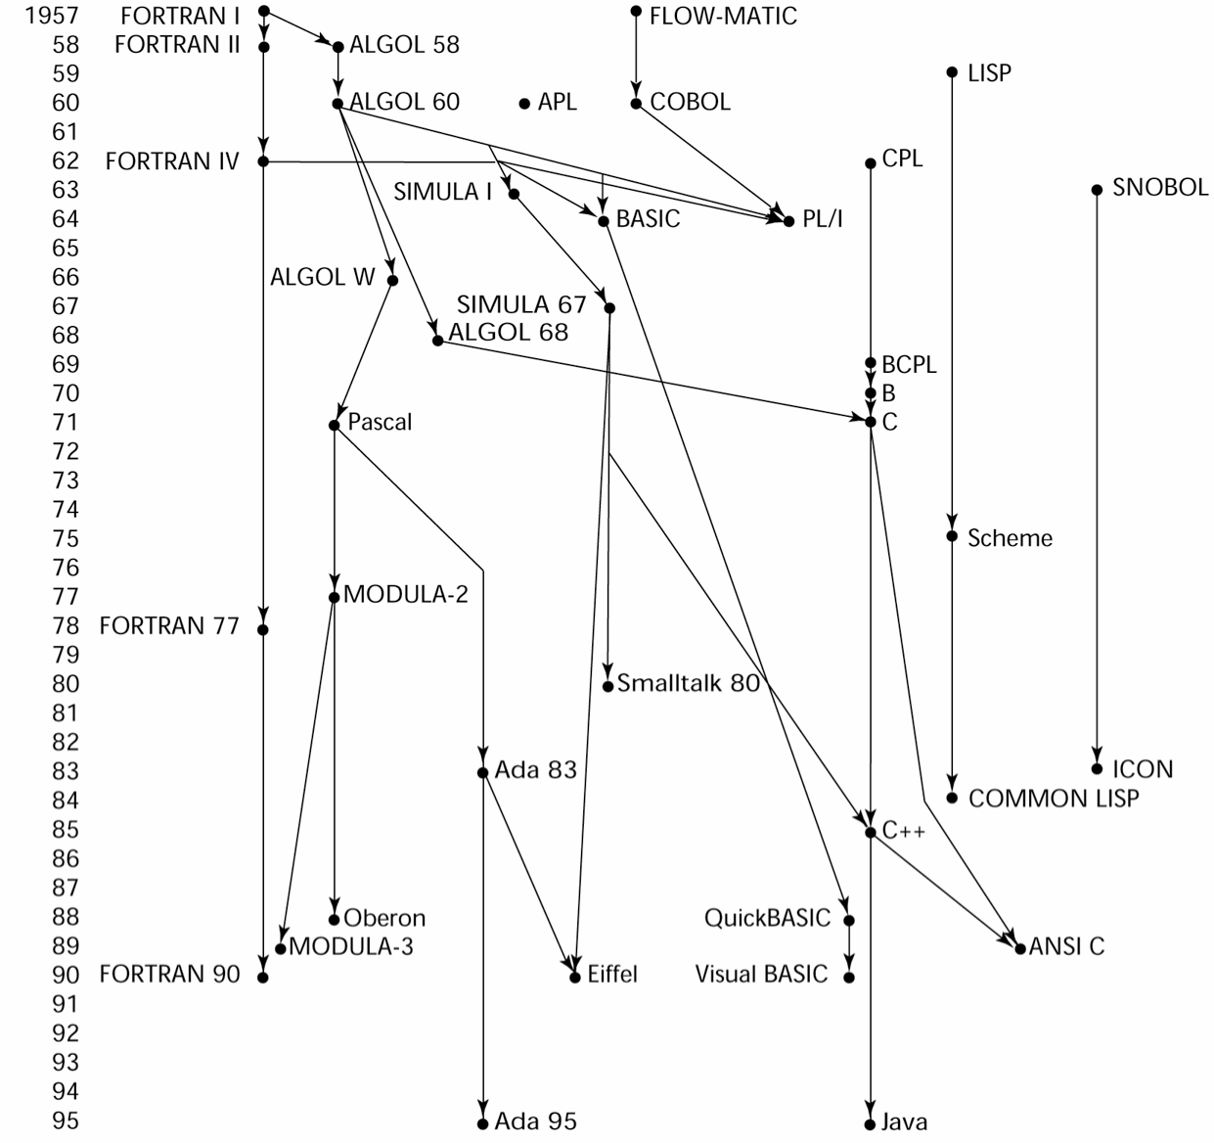
Genealogy of Common Languages

Slide 7
Zuse’s Plankalkül
Never implemented
Advanced data structures
floating point, arrays, records

Slide 8
Plankalkül Syntax
An assignment statement to assign the expression A[4] + 1 to A[5]
| A + 1 => A
V | 4
S | 1.n
5
1.n
(subscripts) (data types)

Slide 9
Minimal Hardware Programming: Pseudocodes
What was wrong with using machine code?
Poor readability
Poor modifiability
Expression coding was tedious
Machine deficiencies--no indexing or floating point

Slide 10
Pseudocodes: Short Code
Short Code developed by Mauchly in 1949
for BINAC computers
Expressions were coded, left to right
Example of operations:
01 – 06 abs value 1n (n+2)nd power
02 ) 07 +
03 = 08 pause
04 / 09 (
2n (n+2)nd root 4n if <= n
58 print and tab

Slide 11
Pseudocodes: Speedcoding
Speedcoding developed by Backus in 1954 for IBM 701
Pseudo ops for arithmetic and math functions
Conditional and unconditional branching
Auto-increment registers for array access
Slow!
Only 700 words left for user program

Slide 12
Pseudocodes: Related Systems
The UNIVAC Compiling System
Developed by a team led by Grace Hopper
Pseudocode expanded into machine code
David J. Wheeler (Cambridge University)
developed a method of using blocks of re- locatable addresses to solve the problem of absolute addressing

Slide 13
IBM 704 and Fortran
Fortran 0: 1954 - not implemented
Fortran I:1957
Designed for the new IBM 704, which had index registers and floating point hardware
Environment of development
Computers were small and unreliable
Applications were scientific
No programming methodology or tools
Machine efficiency was most important

Slide 14
Design Process of Fortran
Impact of environment on design of Fortran I
No need for dynamic storage
Need good array handling and counting loops
No string handling, decimal arithmetic, or powerful input/output (commercial stuff)

Slide 15
Fortran I Overview
First implemented version of Fortran
Names could have up to six characters
Post-test counting loop (DO)
Formatted I/O
User-defined subprograms
Three-way selection statement (arithmetic IF)
No data typing statements

Slide 16
Fortran I Overview (continued)
First implemented version of FORTRAN
No separate compilation
Compiler released in April 1957, after 18 worker-years of effort
Programs larger than 400 lines rarely compiled correctly, mainly due to poor reliability of 704
Code was very fast
Quickly became widely used

Slide 17
Fortran II
Distributed in 1958
Independent compilation
Fixed the bugs

Slide 18
Fortran IV
Evolved during 1960-62
Explicit type declarations
Logical selection statement
Subprogram names could be parameters
ANSI standard in 1966

Slide 19
Fortran 77
Became the new standard in 1978
Character string handling
Logical loop control statement
IF-THEN-ELSE statement

Slide 20
Fortran 90
Most significant changes from Fortran 77
Modules
Dynamic arrays
Pointers
Recursion
CASE statement
Parameter type checking

Slide 21
Fortran Evaluation
Highly optimizing compilers (all versions before 90)
Types and storage of all variables are fixed before run time
Dramatically changed forever the way computers are used
Characterized as the lingua franca of the computing world

Slide 22
Functional Programming: LISP
LISt Processing language
Designed at MIT by McCarthy
AI research needed a language to
Process data in lists (rather than arrays)
Symbolic computation (rather than numeric)
Only two data types: atoms and lists
Syntax is based on lambda calculus

Slide 23
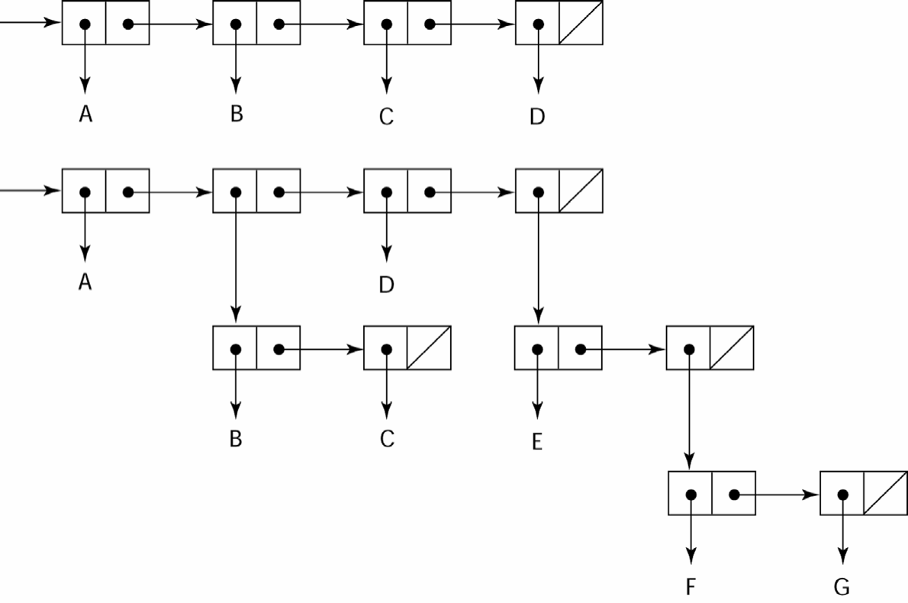
Representation of Two LISP Lists

Slide 24
LISP Evaluation
Pioneered functional programming
No need for variables or assignment
Control via recursion and conditional expressions
Still the dominant language for AI
COMMON LISP and Scheme are contemporary dialects of LISP
ML, Miranda, and Haskell are related languages

Slide 25
Scheme
Developed at MIT in mid 1970s
Small
Extensive use of static scoping
Functions as first-class entities
Simple syntax (and small size) make it ideal for educational applications

Slide 26
COMMON LISP
An effort to combine features of several dialects of LISP into a single language
Large, complex

Slide 27
The First Step Toward Sophistication: ALGOL 60
Environment of development
FORTRAN had (barely) arrived for IBM 70x
Many other languages were being developed, all for specific machines
No portable language; all were machine- dependent
No universal language for communicating algorithms
ALGOL 60 was the result of efforts to design a universal language

Slide 28
Early Design Process
ACM and GAMM met for four days for design (May 27 to June 1, 1958)
Goals of the language
Close to mathematical notation
Good for describing algorithms
Must be translatable to machine code

Slide 29
ALGOL 58
Concept of type was formalized
Names could be any length
Arrays could have any number of subscripts
Parameters were separated by mode (in & out)
Subscripts were placed in brackets
Compound statements (begin ... end)
Semicolon as a statement separator
Assignment operator was :=
if had an else-if clause
No I/O - “would make it machine dependent”

Slide 30
ALGOL 58 Implementation
Not meant to be implemented, but variations of it were (MAD, JOVIAL)
Although IBM was initially enthusiastic, all support was dropped by mid 1959

Slide 31
ALGOL 60 Overview
Modified ALGOL 58 at 6-day meeting in Paris
New features
Block structure (local scope)
Two parameter passing methods
Subprogram recursion
Stack-dynamic arrays
Still no I/O and no string handling

Slide 32
ALGOL 60 Evaluation
Successes
It was the standard way to publish algorithms for over 20 years
All subsequent imperative languages are based on it
First machine-independent language
First language whose syntax was formally defined (BNF)

Slide 33
ALGOL 60 Evaluation (continued)
Failure
Never widely used, especially in U.S.
Reasons
Lack of I/O and the character set made programs non-portable
Too flexible--hard to implement
Entrenchment of Fortran
Formal syntax description
Lack of support from IBM

Slide 34
Computerizing Business Records: COBOL
Environment of development
UNIVAC was beginning to use FLOW-MATIC
USAF was beginning to use AIMACO
IBM was developing COMTRAN

Slide 35
COBOL Historical Background
Based on FLOW-MATIC
FLOW-MATIC features
Names up to 12 characters, with embedded hyphens
English names for arithmetic operators (no arithmetic expressions)
Data and code were completely separate
Verbs were first word in every statement

Slide 36
COBOL Design Process
First Design Meeting (Pentagon) - May 1959
Design goals
Must look like simple English
Must be easy to use, even if that means it will be less powerful
Must broaden the base of computer users
Must not be biased by current compiler problems
Design committee members were all from computer manufacturers and DoD branches
Design Problems: arithmetic expressions? subscripts? Fights among manufacturers

Slide 37
COBOL Evaluation
Contributions
First macro facility in a high-level language
Hierarchical data structures (records)
Nested selection statements
Long names (up to 30 characters), with hyphens
Separate data division

Slide 38
COBOL: DoD Influence
First language required by DoD
would have failed without DoD
Still the most widely used business applications language

Slide 39
The Beginning of Timesharing: BASIC
Designed by Kemeny & Kurtz at Dartmouth
Design Goals:
Easy to learn and use for non-science students
Must be “pleasant and friendly”
Fast turnaround for homework
Free and private access
User time is more important than computer time
Current popular dialect: Visual BASIC
First widely used language with time sharing

Slide 40
Everything for Everybody: PL/I
Designed by IBM and SHARE
Computing situation in 1964 (IBM's point of view)
Scientific computing
IBM 1620 and 7090 computers
FORTRAN
SHARE user group
Business computing
IBM 1401, 7080 computers
COBOL
GUIDE user group

Slide 41
PL/I: Background
By 1963
Scientific users began to need more elaborate I/O, like COBOL had; business users began to need floating point and arrays
It looked like many shops would begin to need two kinds of computers, languages, and support staff--too costly
The obvious solution
Build a new computer to do both kinds of applications
Design a new language to do both kinds of applications

Slide 42
PL/I: Design Process
Designed in five months by the 3 X 3 Committee
Three members from IBM, three members from SHARE
Initial concept
An extension of Fortran IV
Initially called NPL (New Programming Language)
Name changed to PL/I in 1965

Slide 43
PL/I: Evaluation
PL/I contributions
First unit-level concurrency
First exception handling
Switch-selectable recursion
First pointer data type
First array cross sections
Concerns
Many new features were poorly designed
Too large and too complex

Slide 44
Two Early Dynamic Languages: APL and
SNOBOL
Characterized by dynamic typing and dynamic storage allocation
Variables are untyped
A variable acquires a type when it is assigned a value
Storage is allocated to a variable when it is assigned a value

Slide 45
APL: A Programming Language
Designed as a hardware description language at IBM by Ken Iverson around 1960
Highly expressive (many operators, for both scalars and arrays of various dimensions)
Programs are very difficult to read
Still in use; minimal changes

Slide 46
SNOBOL
Designed as a string manipulation language at Bell Labs by Farber, Griswold, and Polensky
Powerful operators for string pattern matching
Slower than alternative languages (and thus no longer used for writing editors)
Stilled used for certain text processing tasks

Slide 47
The Beginning of Data Abstraction:
SIMULA 67
Designed primarily for system simulation in Norway by Nygaard and Dahl
Based on ALGOL 60 and SIMULA I
Primary Contributions
Co-routines - a kind of subprogram
Implemented in a structure called a class
Classes are the basis for data abstraction
Classes are structures that include both local data and functionality

Slide 48
Orthogonal Design: ALGOL 68
From the continued development of ALGOL 60 but not a superset of that language
Source of several new ideas (even though the language itself never achieved widespread use)
Design is based on the concept of orthogonality
few principle concepts, few combining mechanisms

Slide 49
ALGOL 68 Evaluation
Contributions
User-defined data structures
Reference types
Dynamic arrays (called flex arrays)
Comments
Less usage than ALGOL 60
Had strong influence on subsequent languages, especially Pascal, C, and Ada

Slide 50
Early Descendants of ALGOLs
ALGOL languages impacted all imperative languages
Pascal
C
Modula/Modula 2
Ada
Oberon
C++/Java
Perl (to some extent)

Slide 51
Pascal - 1971
Developed by Wirth (a member of the ALGOL 68 committee)
Designed for teaching structured programming
Small, simple, nothing really new
Largest impact on teaching programming
From mid-1970s until the late 1990s, it was the most widely used language for teaching programming

Slide 52
C - 1972
Designed for systems programming (at Bell Labs by Dennis Richie)
Evolved primarily from BCLP, B, but also ALGOL 68
Powerful set of operators, but poor type checking
Initially spread through UNIX
Many areas of application

Slide 53
Perl
Related to ALGOL only through C
A scripting language
A script (file) contains instructions to be executed
Other examples: sh, awk, tcl/tk
Developed by Larry Wall
Perl variables are statically typed and implicitly declared
Three distinctive namespaces, denoted by the first character of a variable’s name
Powerful but somewhat dangerous
Widely used as a general purpose language

Slide 54
Programming Based on Logic: Prolog
Developed, by Comerauer and Roussel (University of Aix-Marseille), with help from Kowalski ( University of Edinburgh)
Based on formal logic
Non-procedural
Can be summarized as being an intelligent database system that uses an inferencing process to infer the truth of given queries
Highly inefficient, small application areas

Slide 55
History’s Largest Design Effort: Ada
Huge design effort, involving hundreds of people, much money, and about eight years
Strawman requirements (April 1975)
Woodman requirements (August 1975)
Tinman requirements (1976)
Ironman equipments (1977)
Steelman requirements (1978)
Named Ada after Augusta Ada Byron, known as being the first programmer

Slide 56
Ada Evaluation
Contributions
Packages - support for data abstraction
Exception handling - elaborate
Generic program units
Concurrency - through the tasking model
Comments
Competitive design
Included all that was then known about software engineering and language design
First compilers were very difficult; the first really usable compiler came nearly five years after the language design was completed

Slide 57
Ada 95
Ada 95 (began in 1988)
Support for OOP through type derivation
Better control mechanisms for shared data
New concurrency features
More flexible libraries
Popularity suffered because the DoD no longer requires its use but also because of popularity of C++

Slide 58
Object-Oriented Programming: Smalltalk
Developed at Xerox PARC, initially by Alan Kay, later by Adele Goldberg
First full implementation of an object- oriented language (data abstraction, inheritance, and dynamic type binding)
Pioneered the graphical user interface design
Promoted OOP

Slide 59
Combining Imperative and Object- Oriented Programming: C++
Developed at Bell Labs by Stroustrup in 1980
Evolved from C and SIMULA 67
Facilities for object-oriented programming, taken partially from SIMULA 67
Provides exception handling
A large and complex language, in part because it supports both procedural and OO programming
Rapidly grew in popularity, along with OOP
ANSI standard approved in November 1997
Microsoft’s version (released with .NET in 2002): Managed C++
delegates, interfaces, no multiple inheritance

Slide 60
Related OOP Languages
Eiffel (designed by Bertrand Meyer - 1992)
Not directly derived from any other language
Smaller and simpler than C++, but still has most of the power
Lacked popularity of C++ because many C++ enthusiasts were already C programmers
Delphi (Borland)
Pascal plus features to support OOP
More elegant and safer than C++

Slide 61
An Imperative-Based Object-Oriented Language: Java
Developed at Sun in the early 1990s
C and C++ were not satisfactory for embedded electronic devices
Based on C++
Significantly simplified (does not include struct, union, enum, pointer arithmetic, and half of
the assignment coercions of C++)
Supports only OOP
Has references, but not pointers
Includes support for applets and a form of concurrency

Slide 62
Java Evaluation
Eliminated unsafe features of C++
Concurrency features
Libraries for applets, GUIs, database access
Portable: Java Virtual Machine concept, JIT compilers
Widely used for WWW pages
Use for other areas increased faster than any other language
Most recent version, 5.0, released in 2004

Slide 63
Scripting Languages for the Web
JavaScript
A joint venture of Netscape and Sun Microsystems
Used in Web programming (client side) to create dynamic HTML documents
Related to Java only through similar syntax
PHP
PHP: Hypertext Preprocessor
Used for Web applications (server side); produces HTML code as output
Python
An OO interpreted scripting language
Type checked but dynamically typed
Supports CGI and form processing

Slide 64
A C-Based Language for the New Millennium: C#
Part of the .NET development platform
Based on C++ , Java, and Delphi
Provides a language for component-based software development
All .NET languages (C#, Visual BASIC.NET, Managed C++, J#.NET, and Jscript.NET) use Common Type System (CTS), which provides a common class library
Likely to become widely used

Slide 65
Markup/Programming Hybrid
Languages
XSLT
eXtensible Markup Language (XML): a metamarkup language
eXtensible Stylesheet Language Transformation (XSTL) transforms XML documents for display
Programming constructs (e.g., looping)
JSP
Java Server Pages: a collection of technologies to support dynamic Web documents
servlet: a Java program that resides on a Web server; servlet’s output is displayed by the browser

Slide 66
Summary
Development, development environment, and evaluation of a number of important programming languages
Perspective into current issues in language design

Slide 67


